Slide 1

VELAMMAL COLLEGE OF ENGINEERING AND TECHNOLOGY
PAPER PRESENTATION
TITLE :Commercial Power Saver Project
Presented By: Hrithik Vel.B(913119105022)
Jeyvishnu V.BA(913119105028)
Vijay KrishnaT.K.B (913119105304)
Guided By : Dr.S.Chellam M.E,Ph.D AP III/Dept Of EEE VCET

Slide 2
Objective
Our Project proposes to minimize the energy consumption and thus reduce the power loss in industries and establishments by making use of a number of shunt capacitors.
This substantially reduces the electricity bill in industries and establishments.
The power factor is also known as the ratio of real power to apparent power. It is also known represented as KW/KVA.

Slide 3
Problem Identification
The problem that we as a group are going to focus through our research is on how has been identified and to rectified by arduino.
In this concern, interfacing is easy to write and upload computer code to the physical board in arduino, in arduino we can communicate the information.
In processor we cannot change the value in same time due to this the program(processor) started from the first whereas in arduino we can only change the value at the time.
Simple ports are used in arduino.

Slide 4
Literature Survey
SL.NO | Author | Title | Description
1 | Dr.Sukhdeo Sao and K.Prasada Rao | Power saver for industrial and commercial establishments by power factor compensation (2019) | Proposed system the lag between zero voltage and zero current pulse duly generated by Suitable operational amplifier modes are fed to two interrupt pins of microcontroller.
2 | Swapnil Namekar and Tushar Sawle | Experimental study on power saver establishment for commercial purpose(2020) | By Installing suitable size power capacitor into circuit the facility factor is improved and therefore the values becomes nearer to 0.9 to 0.95 has minimizing line losses.
3 | Mr.Jadhav Rohit, Mr.Bhor Ashish and Miss Handore Saloni | Power saver for industrial and commercial establishment(2018) | The program takes over to actuate shunt capacitors into load circuit to get zero power loss by using 8051 microcontroller.

Slide 5
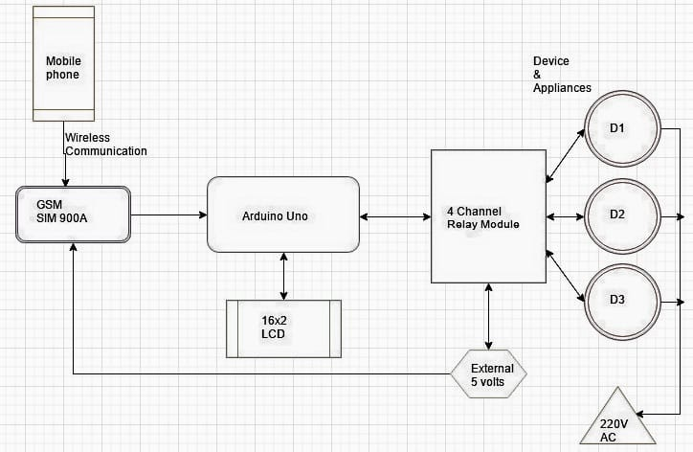
Block Diagram

Slide 6
Advantages Of This Project
Do not need external Programmer and the device is inexpensive.
Arduino consumes less power which the input has analog to digital input such as sensor data like light ,temperature and sound.
It is used in digital sensors like SPI and 12C.
This arduino is programmed with a C/C++dialect language are used.

Slide 7
Reference
[1]Dr.Sukhdeo Sao and K.Prasada Rao-Power saver for industrial and commercial establishments by power factor compensation-’International research journal of engineering and technology(IRJET)’-April 2019-Volume:06 Issue:04-PP.2806-2812.
[2]Swapnil Namekar and Tushar Sawle-Experimental study on power saver establishment for commercial purpose-’International journal of scientific research and engineering development’-March-April 2020-Volume:03 Issue:02-PP.2806-2812.
[3]Mr.Jadhav Rohit, Mr.Bhor Ashish and Miss Handore Saloni-Power saver for industrial and commercial establishment-’International journal of advanced engineering and research development’-May 2018-Volume:05 Issue:05-PP.667-672.

Slide 8
[4]Vishal Vaibhav and Varsha Mehar-A review on power saver establishments for industrial and commercial purpose-’International journal of engineering sciences and research technology’-September 2018-Volume:07 Issue:09-PP.107-113.
[5]Mr.Naryanan Swamy.R and Dr.G.Mahadevan-Power Saving Device-’International journal of scientific and technology research’-August 2012-PP.14-16.

Slide 9
Thank You

